Slide 1
A Hybrid Deep Learning Approach for Bottleneck Detection in IoT
Batch:14
Guide: Mr. G. Venu Gopal Rao
Presented by:
B. Rajesh (20R01A6606) K. Karthik (20R01A6624) M. Yashaswini Reddy (20R01A6635) V. Bhavan Teja (20R01A6657)

Slide 2
CONTENTS
Abstract
Introduction
Objective
Literature Survey
Existing system
Disadvantages
Proposed system
Advantages
Algorithms Used
Modules
System architecture
Conclusion
Future Enhancements

Slide 3
ABSTRACT
Cloud computing is a cost-effective innovation that reduces upfront hardware expenses by offering on-demand computing resources.Fog computing is an additional help to cloud infrastructure by reducing the end client’s reaction time, such as IoT. However, most of the IoT devices are resource-constrained, and there are many devices that cyber attacks could target. Cyber-attacks such as Dos, DDoS, and botnets are still significant threats in the IoT environment. Botnets are currently the most significant threat on the internet. To address this,botnet attack detection approach is proposed for fog computing, leveraging the programmable nature of software-defined networks (SDN). The method outperforms previous techniques.

Slide 4
INTRODUCTION:
One of the most significant issues for the network system to be efficient and reliable while doing transactions over the IoT is security . The tremendous growth of IoT in different fields, i.e., surveillance, healthcare, transportation, manufacturing industry, education, and others, encourages securing IoT infrastructure to improve its performance.
Earlier IoT devices generate data through various types of sensors, and the fog server with malicious intent to lower its performance.
Hence, security and protection of the system are among the major issues that can affect the performance of fog computing
In the fog computing paradigm security is still challenging task, and various security schemes are proposed to make it resilient against vulnerabilities.

Slide 5
OBJECTIVE
The key objective of this presentation are:
Showcase cloud computing as a cost-effective innovation.
Highlight the role of fog computing in enhancing cloud infrastructure.
Identify and address cyber threats in IoT devices.
Highlight the significance of botnets as a major cyber threat.
Propose a novel approach for botnet attack detection in fog computing.
Achieve a high level of accuracy in botnet attack detection.

Slide 6
LITERATURE SURVEY
Security remained one of the top research areas in networking paradigms whether it is based on cloud computing ,fog computing ,IoT or SCADA (Supervisory Control and Data Acquisition) systems , or others. Several researchers are focusing on detecting botnet attacks these days .
The main requirement in botnet detectionwhile the SVM model was at 95% accuracy. Ye et al. also used the SVM algorithm and achieved an average accuracy of 95.24%. Exeperiments are also performed using various algorithms such as Naive Bayesian and decision tree classifier algorithms.

Slide 7
EXISTING SYSTEM
The existing system for botnet detection predominantly relies on machine learning (ML) techniques, including BayesNet, Support Vector Machine (SVM), J48, Decision Tree, and Naive Bayes. Notable experiments using K-Nearest Neighbors (KNN), SVM, and NB revealed that KNN excels in detecting Botnet attacks with 97% accuracy. Additional studies demonstrated the effectiveness of SVM with proposed adjustments, outperforming alternative methods. While ML algorithms are widely used, they fall short in handling the extensive and unstructured data produced by IoT devices. This limitation has led to a preference for deep learning (DL) algorithms in the existing system, as they prove more adept at addressing IoT data challenges and detecting various kinds of malware in IoT devices.

Slide 8
DISADVANTAGES
An existing system is not hybrid deep learning detection policy to improve the efficiency and effectiveness of the SDN-based fog computing architecture. Results show that the proposed scheme works better and provides a better detection rate.
can't customize the policies and applications dues to its programmable nature.
they fall short in handling the extensive and unstructured data produced by IoT devices

Slide 9
PROPOSED SYSTEM
The system introduces a highly effective deep learning framework designed for the detection of Botnet attacks within an SDN-based fog computing environment. To validate its performance, practical experiments are conducted using the N_BaIoT Dataset, which encompasses both Botnet attack and benign samples. The proposed technique undergoes evaluation using established performance metrics for machine and deep learning algorithms, including precision, F1-score, recall, accuracy, among others. In pursuit of unbiased results, the 10-fold-cross-validation technique is applied to ensure robust assessment and reliability.

Slide 10
ADVANTAGES
Manages secure connections for thousands of devices on the fog for data transmission.
Provides real-time monitoring and awareness with low latency.
Dynamically balances the load through its flexible architecture.

Slide 11
ALGORITHMS
Decision Tree Classifiers: Tree-based models that capture decision-making knowledge from data by recursively partitioning it based on tests.
Gradient Boosting: Ensemble learning technique creating a predictive model, often trees, in a stage-wise manner, optimizing a differentiable loss function.
K-Nearest Neighbors (KNN): Simple, powerful classification algorithm relying on majority class among the k-nearest neighbors in feature space.
Logistic Regression Classifiers: Analyzes association between a categorical dependent variable and independent variables, suitable for binary or multinomial outcomes, without assuming normal distribution.

Slide 12
Naïve Bayes: Supervised learning method assuming independence of features given the class, performing well due to simplicity and ease of implementation.
Random Forest: Ensemble learning method constructing multiple decision trees during training, correcting for overfitting, and often outperforming individual trees.
Support Vector Machine (SVM): Discriminant technique finding a hyperplane to separate classes in feature space, providing a unique solution due to solving the convex optimization problem analyticall

Slide 13
MODULES
Service Provider:In this module, the Service Provider has to login by using valid user name and password. After login successful he can do some operations such as Login, Train & Test Data Sets, View Trained and Tested Accuracy in Bar Chart, View Trained and Tested Accuracy Results, View Prediction Of Attack Type, View Attack Type Ratio, Download Predicted Data Sets, View Attack Type Ratio Results, View All Remote Users.
View and Authorize Users :In this module, the admin can view the list of users who all registered. In this, the admin can view the user’s details such as, user name, email, address and admin authorizes the users.
Remote User:In this module, there are n numbers of users are present. User should register before doing any operations. Once user registers, their details will be stored to the database. After registration successful, he has to login by using authorized user name and password. Once Login is successful user will do some operations like REGISTER AND LOGIN, PREDICT ATTACK TYPE, VIEW YOUR PROFILE.

Slide 14
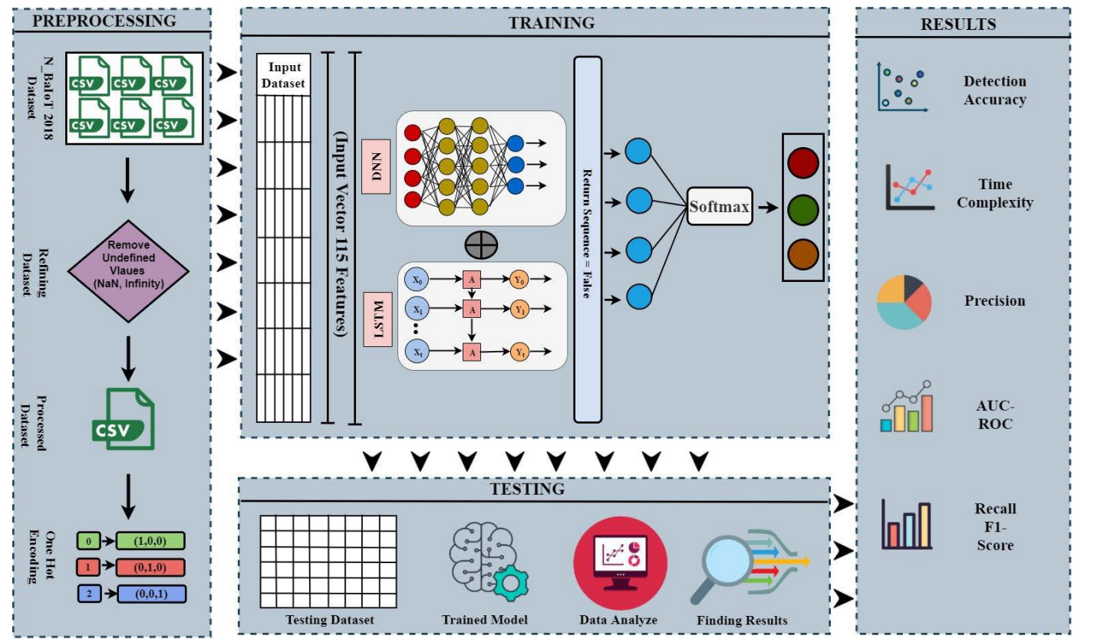
SYSTEM ARCHITECTURE

Slide 15
CONCLUSION
In conclusion, the proposed "Hybrid Deep Learning Approach for Botnet Detection in IoT" presents a promising strategy to address the intricate challenges of identifying and mitigating botnet threats within Internet of Things (IoT) environments. By combining the strengths of deep learning algorithms with a hybrid framework, the approach aims to enhance the accuracy and adaptability of botnet detection. Leveraging this methodology offers the potential to effectively handle the extensive and unstructured data generated by IoT devices, surpassing the limitations of traditional machine learning techniques. This innovative approach underscores a proactive stance in fortifying IoT systems against evolving security threats, thereby contributing to the resilience and robustness of IoT infrastructures

Slide 16
FUTURE ENCHANCEMENT
DNN (Deep Neural Network): DNNs are good at extracting general features and relationships from data. They can help identify subtle changes in network traffic patterns that might indicate botnet activity.
LSTM (Long Short-Term Memory): LSTMs are able to learn from long sequences of data and handle temporal dependencies. This makes them ideal for analyzing time-series data like network traffic, where the order of events can be crucial for identifying attacks.

